Slide 1

Computer Graphics
Week 7: 3D Graphics in WebGL

Slide 2
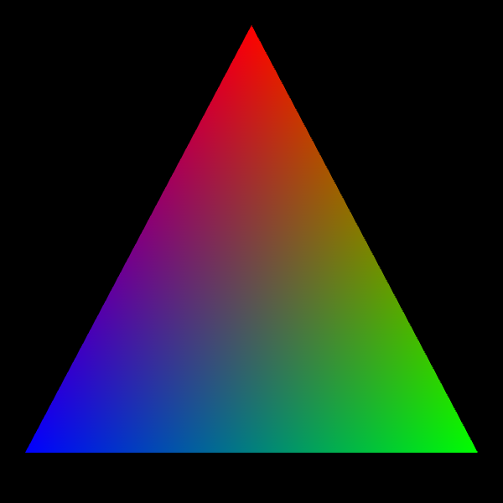
Review: The First Example
Notes:
https://math.hws.edu/graphicsbook/source/webgl/webgl-rgb-triangle.html

Slide 3
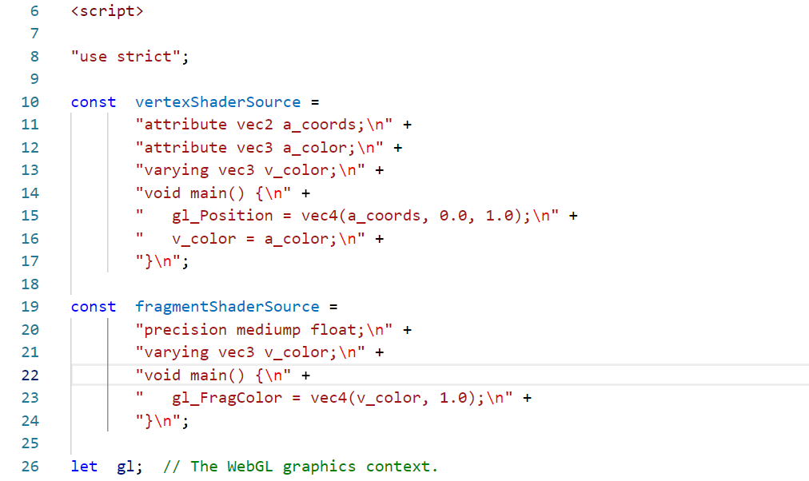
Review: The First Example
Vertex shader:
Set the gl_Position with the attributes data
containing the 2D vertex coordinates
Set the varying data with the attributes of
RGB color values
Fragment shader:
Set the gl_Fragcolor with the varying data
containing the RGB color values
Notes:
https://math.hws.edu/graphicsbook/source/webgl/webgl-rgb-triangle.html

Slide 4
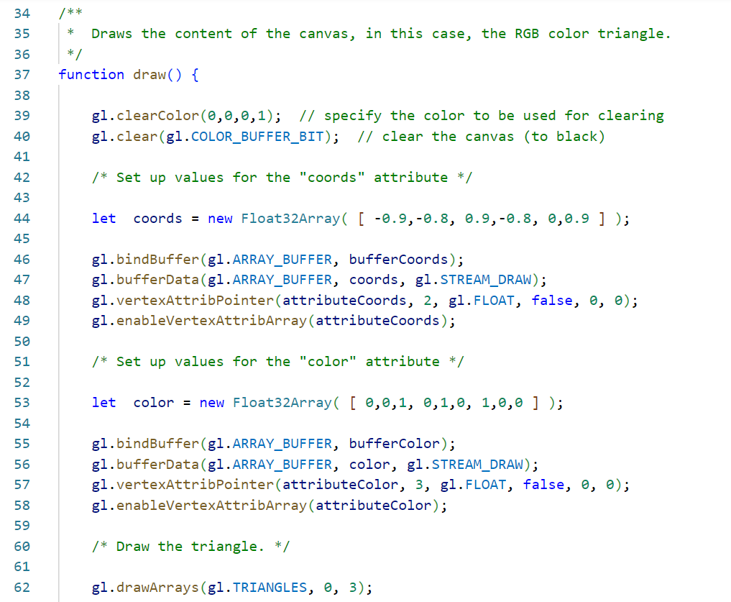
Review: The First Example
The draw function:
Set the background color to black
Set an array for the 2D coordinates:
[ -0.9, -0.8, 0.9, -0.8, 0, 0.9 ]
Recall that the default view volume is a cube
of side 2, centered at the origin
Send the array to the GPU via an array buffer
The same steps also taken for the RGB colors
Set an array for the RGB color values:
[ 0, 0, 1, 0, 1, 0, 1, 0, 0 ]
Send the array to the GPU via an array buffer
Draw the object using the webGL drawArrays
method
Notes:
https://math.hws.edu/graphicsbook/source/webgl/webgl-rgb-triangle.html

Slide 5
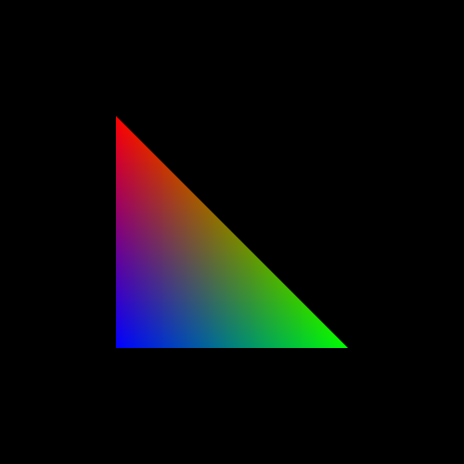
Exercise 1
Modify the draw function:
Look at the color data:
[ 0, 0, 1, 0, 1, 0, 1, 0, 0 ]
The order was Blue, Green, and Red
The Blue vertex needs to be in the middle of the
lower left quadrant: ( -0.5, -0.5)
The Green vertex needs to be in the middle of the
lower right quadrant: (0.5, -0.5)
The Red vertex needs to be in the middle of the
upper left quadrant: ( -0.5, 0.5)
Hence, set the array for the 2D coordinates as in:
[ -0.5, -0.5, 0.5, -0.5, -0.5, 0.5 ]

Slide 6
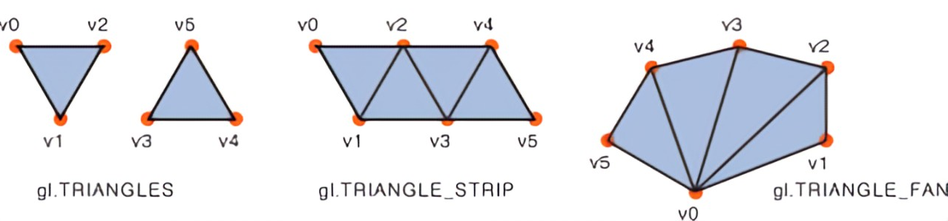
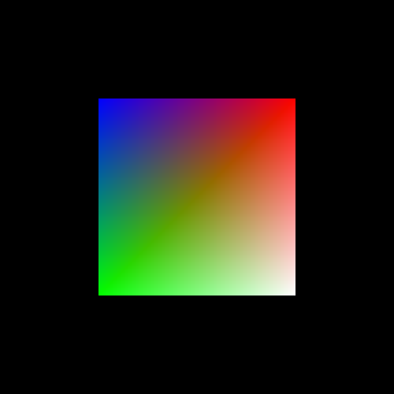
Exercise 2
There are several solutions to this.
One is by drawing a triangle strip, composed of 4 vertices.
Look at the color values of the sample triangle program.
We need to add one more color: the white
Modify the color array into: [ 0,0,1, 0,1,0, 1,0,0, 1,1,1 ]
Modify the coordinates array into:
[ -0.5,0.5, -0.5,-0.5, 0.5,0.5, 0.5,-0.5 ]
Modify the drawArray command into:
gl.drawArrays(gl.TRIANGLE_STRIP, 0, 4);
Other solutions could draw two triangles using 6 vertices,
or draw a triangle fan using 4 vertices.

Slide 7

3D Graphics

Slide 8
3D Coordinates
What differ 3D coordinates and the 2D ones?
What are the characteristics of the x-, y-, and z-axis?
Convention in OpenGL: the positive z-axis directs to the viewer/camera, and the negative z-axis goes away from the viewer/camera
This is known as the right-handed coordinate system

Slide 9
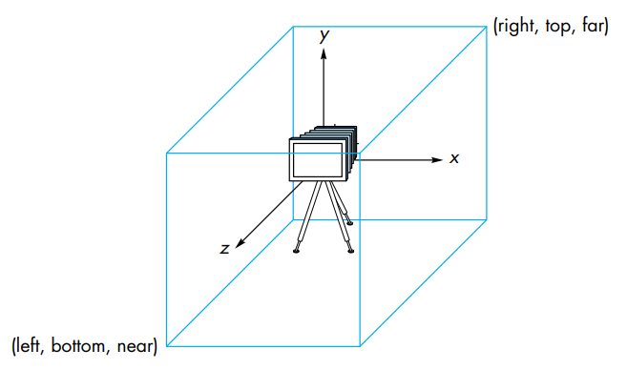
Camera and Viewing Volume
Default camera position: (0, 0, 0)
Viewing volume: a cube centered on the origin (0, 0, 0) with side-length of 2

Slide 10
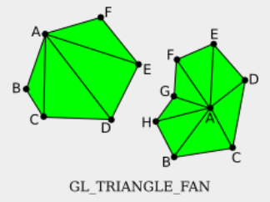
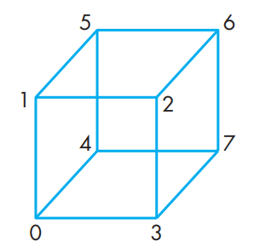
Example: Draw a 3D Cube
A 3D cube has 6 square sides
Each square can be drawn using a TRIANGLE_FAN primitive
Suppose that we will draw a cube centered at (0, 0, 0) with a side length of 1, then the coordinates needed are:
  Coordinate 0:
  Coordinate 1:
  Coordinate 2:
  Coordinate 3:
  Coordinate 4:
  Coordinate 5:
  Coordinate 6:
  Coordinate 7:

Slide 11
Example: Draw a 3D Cube
A 3D cube has 6 square sides
Each square can be drawn using a TRIANGLE_FAN primitive
Suppose that we will draw a cube centered at (0, 0, 0) with a side length of 1, then the coordinates needed are:
  Coordinate 0: (-0.5, -0.5, 0.5)
  Coordinate 1: (-0.5, 0.5, 0.5)
  Coordinate 2: (0.5, 0.5, 0.5)
  Coordinate 3: (0.5, -0.5, 0.5)
  Coordinate 4: (-0.5, -0.5, 0.5)
  Coordinate 5: (-0.5, 0.5, -0.5)
  Coordinate 6: (0.5, 0.5, -0.5)
  Coordinate 7: (0.5, -0.5, -0.5)

Slide 12
Example: Draw a 3D Cube
A 3D cube has 6 square sides
Each square can be drawn using a TRIANGLE_FAN primitive
Suppose that we will draw a cube centered at (0, 0, 0) with a side length of 1, then the coordinates needed are:
  Coordinate 0: (-0.5, -0.5, 0.5)
  Coordinate 1: (-0.5, 0.5, 0.5)
  Coordinate 2: (0.5, 0.5, 0.5)
  Coordinate 3: (0.5, -0.5, 0.5)
  Coordinate 4: (-0.5, -0.5, 0.5)
  Coordinate 5: (-0.5, 0.5, -0.5)
  Coordinate 6: (0.5, 0.5, -0.5)
  Coordinate 7: (0.5, -0.5, -0.5)
Draw the 3D cube as six faces:
Front face (red) : 0321
Back face (green) : 4567
Top face (blue) : 5126
Bottom face (red-green/yellow) : 4730
Right face (red-blue/fuchsia) : 7623
Left face (green-blue/aqua) : 4015

Slide 13
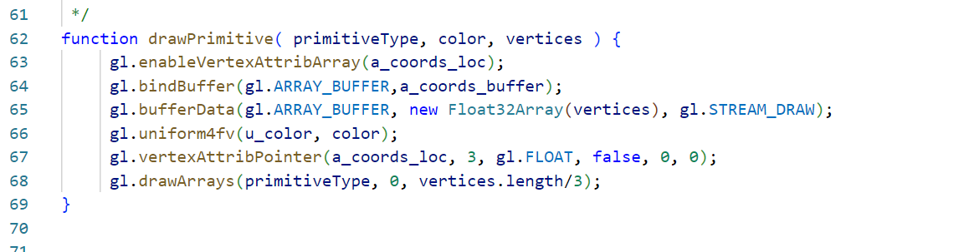
Example: Draw a 3D Cube
The drawPrimitive function:
  send vertex coordinates via an array buffer
  send color data via a uniform variable
  draw a primitive of a specified type

Slide 14
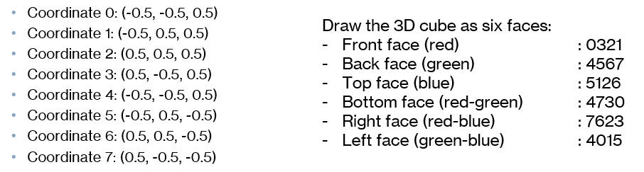
Example: Draw a 3D Cube
Call the drawPrimitive function 6 times:
    drawPrimitive( gl.TRIANGLE_FAN, [1,0,0,1], [ -0.5,-0.5,0.5, 0.5,-0.5,0.5, 0.5,0.5,0.5, -0.5,0.5,0.5 ]);
    drawPrimitive( gl.TRIANGLE_FAN, [0,1,0,1], [ -0.5,-0.5,-0.5, -0.5,0.5,-0.5, 0.5,0.5,-0.5, 0.5,-0.5,-0.5 ]);
    drawPrimitive( gl.TRIANGLE_FAN, [0,0,1,1], [ -0.5,0.5,-0.5, -0.5,0.5,0.5, 0.5,0.5,0.5, 0.5,0.5,-0.5 ]);
    drawPrimitive( gl.TRIANGLE_FAN, [1,1,0,1], [ -0.5,-0.5,-0.5, 0.5,-0.5,-0.5, 0.5,-0.5,0.5, -0.5,-0.5,0.5 ]);
    drawPrimitive( gl.TRIANGLE_FAN, [1,0,1,1], [ 0.5,-0.5,-0.5, 0.5,0.5,-0.5, 0.5,0.5,0.5, 0.5,-0.5,0.5 ]);
    drawPrimitive( gl.TRIANGLE_FAN, [0,1,1,1], [ -0.5,-0.5,-0.5, -0.5,-0.5,0.5, -0.5,0.5,0.5, -0.5,0.5,-0.5 ]);

Slide 15
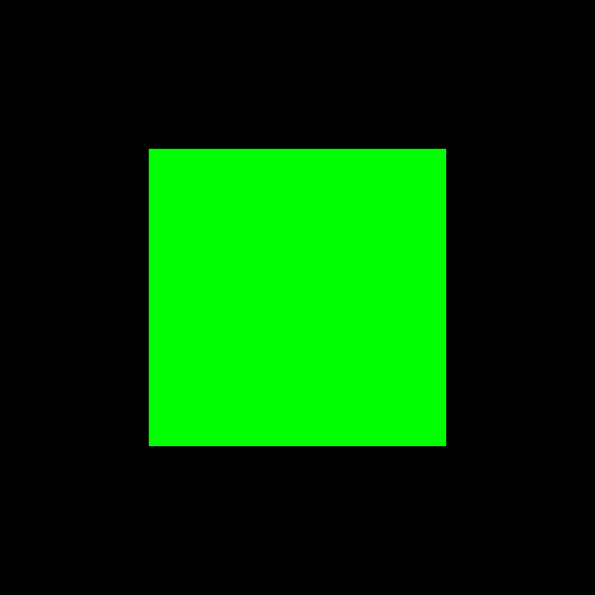
Output
Default projection: orthographic
Which side is it?

Slide 16
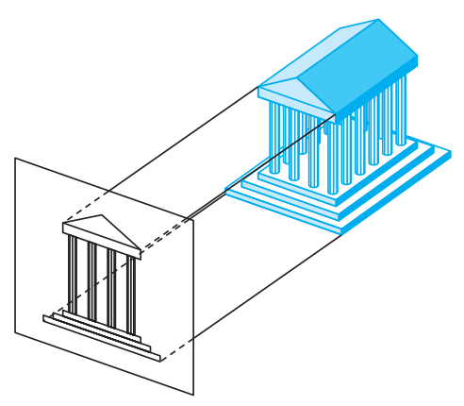
Orthographic Projection
Default projection used by WebGL (OpenGL)

Slide 17
Student Activity
Play around with the 3D coordinates, for example, try to show another side of the 3D cube.

Slide 18
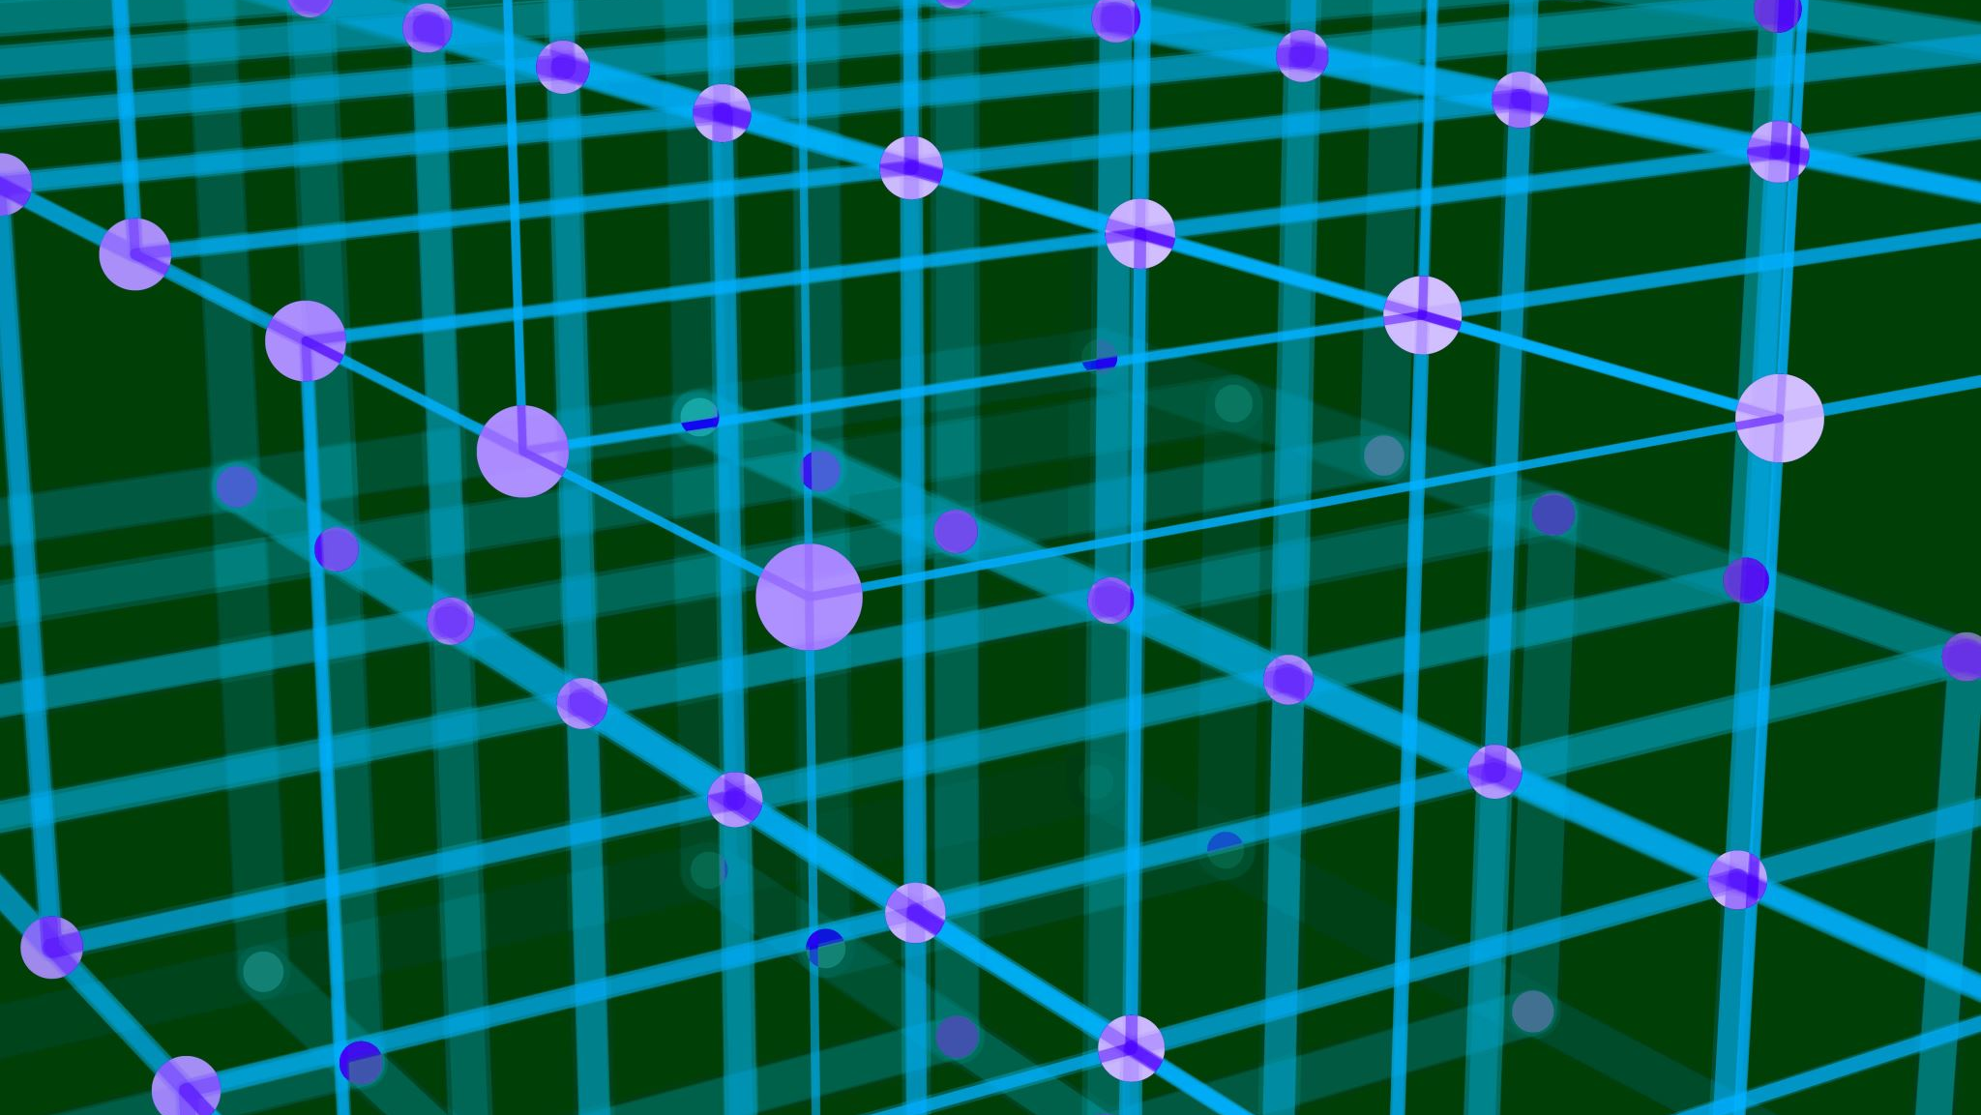
3D Transformation

Slide 19
3D Transformation
Basic 3D transformation: 3D translation, 3D rotation, 3D scaling
3D translation
  How many parameters needed?
3D scaling
  How many parameters needed?

Slide 20
3D rotation
2D rotation: rotation about a point
3D rotation: rotation about a line or a rotation axis
  For example: the rotation of the earth
3D rotation axis:
  The x axis
  The y axis
  The z axis

Slide 21
3D rotation
Besides the rotation axis parameter, a 3D rotation also needs the rotation angle
The right-hand system is used to define the positive or the negative angle of 3D rotation

Slide 22
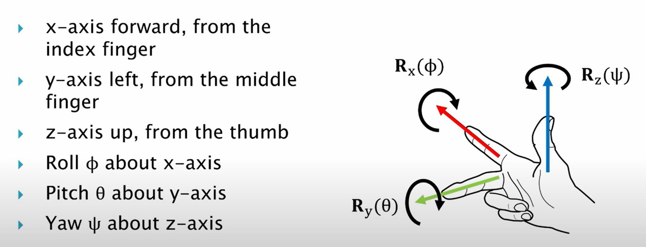
3D rotation
The right-hand rule:

Slide 23
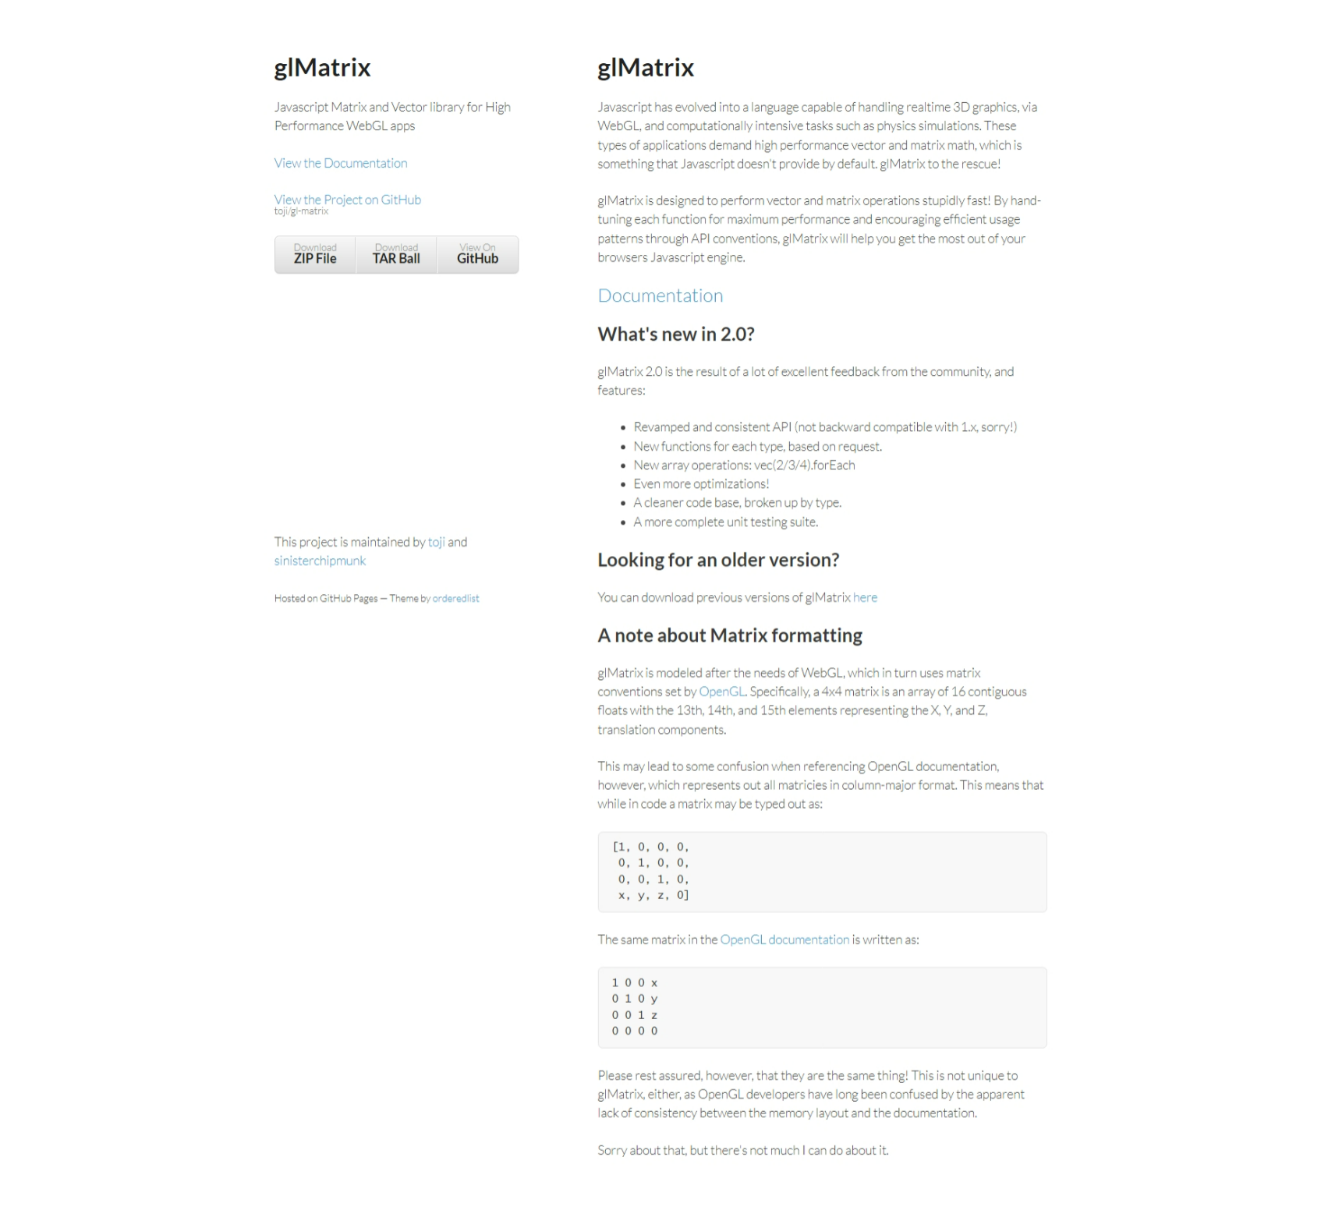
glMatrix
WebGL API does not provide functions of transformations
glMatrix: JavaScript library for transformation
  free, created by Brandon Jones and Colin MacKenzie IV
  http://glmatrix.net

Slide 24
glMatrix
gl-matrix-min.js: a mini version of glMatrix
<script src="gl-matrix-min.js"></script>
The glMatrix library has ‘class’ of vec2, vec3, vec4, mat2, mat3, mat4 that can be sent to a shader program to specify the same class in GLSL
The create() function is used to create an object class with the class’ default length and default values
  transform = mat4.create();
  vector = vec3.create();
Other functions do not create new objcets, but they modify existing objects
  mat4.multiply(A,B,C)

Slide 25
glMatrix
Has functions for multiplying matrix with standard transformation matrices such as translation, scaling and rotation
  mat4.translate( modelview, modelview, [dx,dy,dz] );
  mat4.scale( modelview, modelview, [sx,sy,sz] );
  mat4.rotateX( modelview, modelview, radians );
  mat4.rotateY( modelview, modelview, radians );
  mat4.rotateZ( modelview, modelview, radians );
  mat4.rotate( modelview, modelview, radians, [dx,dy,dz] );
Sample program: mycube.html

Slide 26
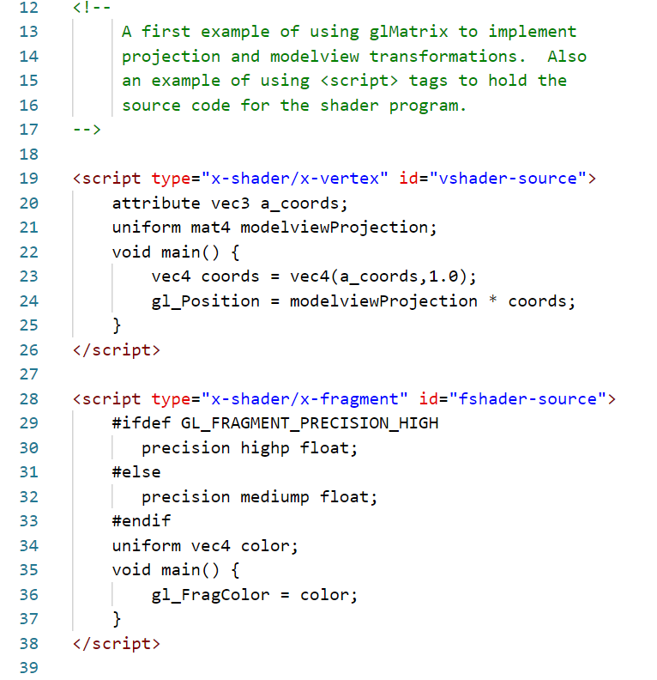
mycube.html
The shaders are written inside the <script> tags
The vertex shader
  Read an attribute data (3D vertices) from the buffer
  Set the gl_Position by the multiplication of 4x4 transformation matrix and the 4D vector
The fragment shader
  Read a uniform color data (RGBA)
  Set the gl_FragColor by the uniform color

Slide 27
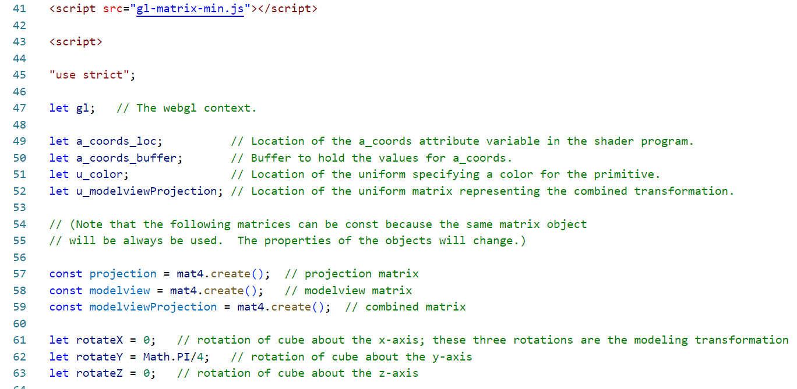
mycube.html
Draw the 3D cube as six faces:
Front face (red) : 0321
Back face (green) : 4567
Top face (blue) : 5126
Bottom face (red-green/yellow) : 4730
Right face (red-blue/fuchsia) : 7623
Left face (green-blue/aqua) : 4015
The global variables in the JavaScript
If the object is rotated about the y-axis using the above angle, which face should appear in the final image?

Slide 28
mycube.html
The drawPrimitive function is the same as the previous example:
  send vertex coordinates via an array buffer
  send color data via a uniform variable
  draw a primitive of a specified type

Slide 29
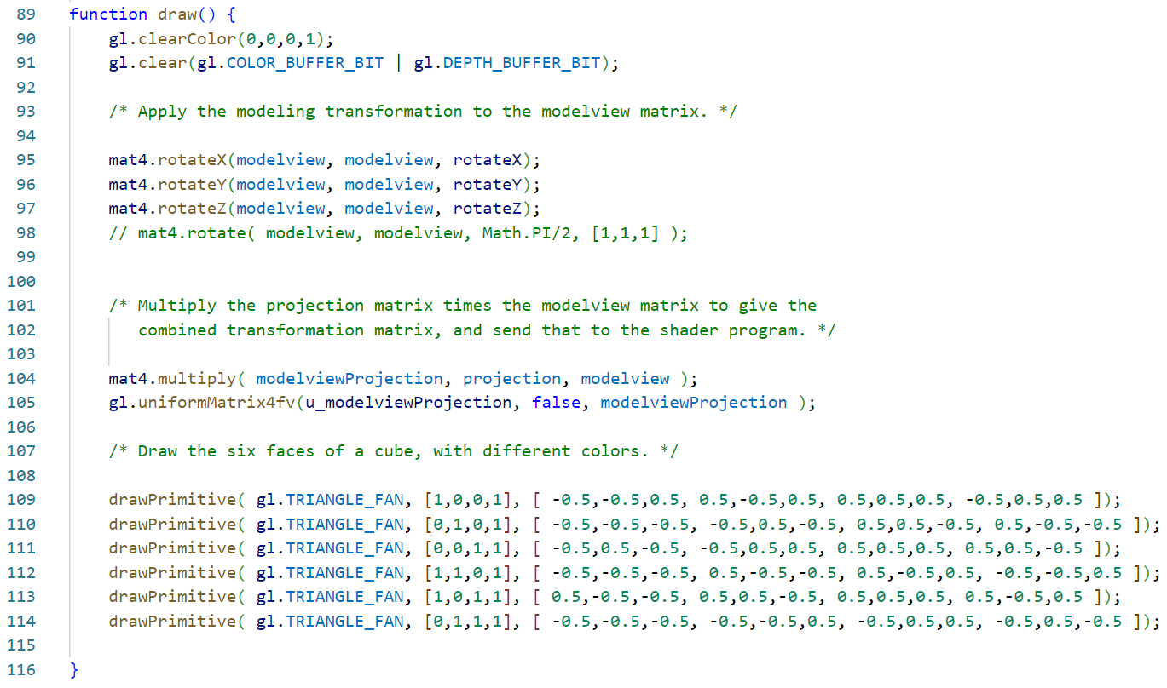
mycube.html
The draw function
  Set the background color to black
  Call the transformation methods needed
    Set the modelview matrix as the result of rotation about X, Y, and Z
    Set the modelviewProjection matrix as the multiplication of projection and modelview matrices
    Send the modelviewProjection to the GPU as a uniform matrix
  Draw the object using the drawPrimitive method

Slide 30
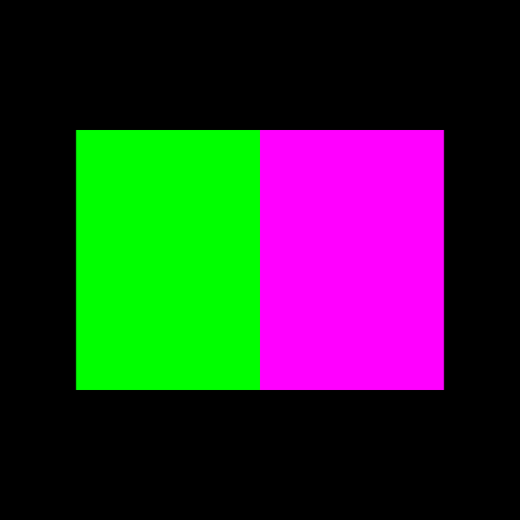
mycube.html

Slide 31

Projection and Viewing

Slide 32
View Volume
Objects outside of the view volume will be clipped-out, do not appear on the final image

Slide 33
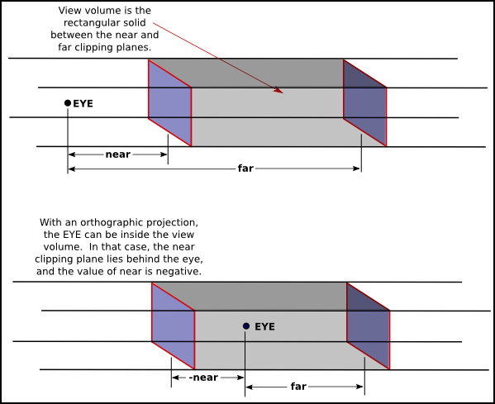
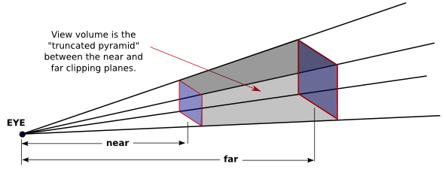
Projection
Two types:
  Orthographic: the default
  Perspective
Which type will produce a more realistic images?

Slide 34
glMatrix
Functions in glMatrix to perform projections and viewing
  mat4.ortho( projection, left, right, bottom, top, near, far );
  mat4.frustum( projection, left, right, bottom, top, near, far );
  mat4.perspective( projection, fovyInRadians, aspect, near, far );
  mat4.lookAt( modelview, [eyex,eyey,eyez], [refx,refy,refz], [upx,upy,upz] );

Slide 35
  mat4.ortho( projection, left, right, bottom, top, near, far );
left, right, bottom, top : the x- and y-coordinates of the left, right, bottom and top of a view volume
See the example

Slide 36

  mat4.frustum( projection, left, right, bottom, top, near, far );
left, right, bottom, top : the x- and y-coordinates of the left, right, bottom and top of a view volume
See the example

Slide 37
  mat4.perspective( projection, fovyInRadians, aspect, near, far );
fovyInRadians : vertical angle in radian = angle between upper-side and lower-side of a view volume
aspect : aspect ratio of the view

Slide 38
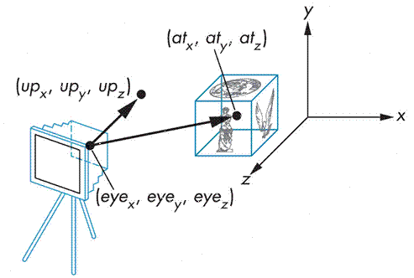
  mat4.lookAt( modelview, [eyex,eyey,eyez], [refx,refy,refz], [upx,upy,upz] );
[eyex,eyey,eyez] : coordinates of camera position
[refx,refy,refz] : coordinates of camera direction position
[upx,upy,upz] : up-direction vector on the view

Slide 39
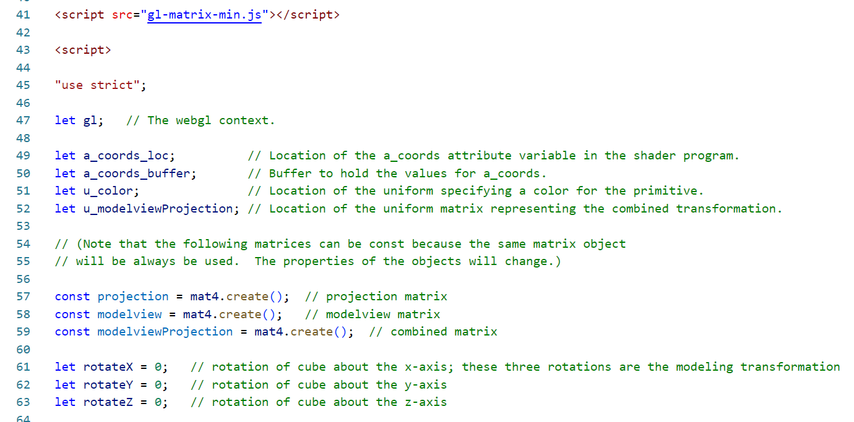
Example: mycube_2.html
The global variables in the JavaScript

Slide 40
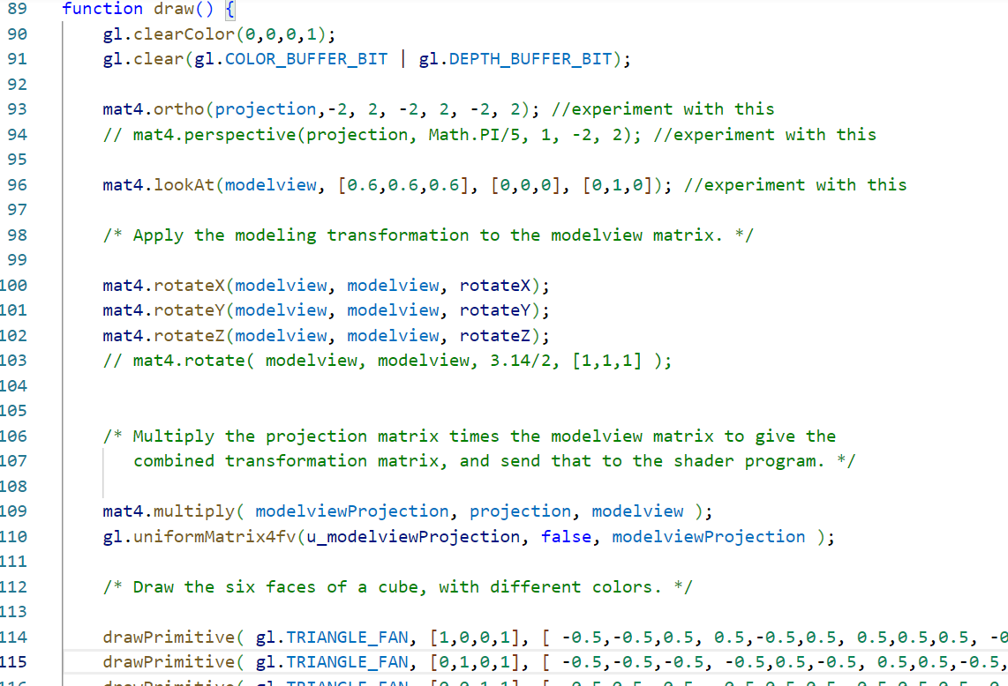
mycube_2.html
The projection properties are reassigned as the result of orthographic projection
The modelview properties are reassigned as the result of lookAt method
The rest of the code is as the previous example

Slide 41
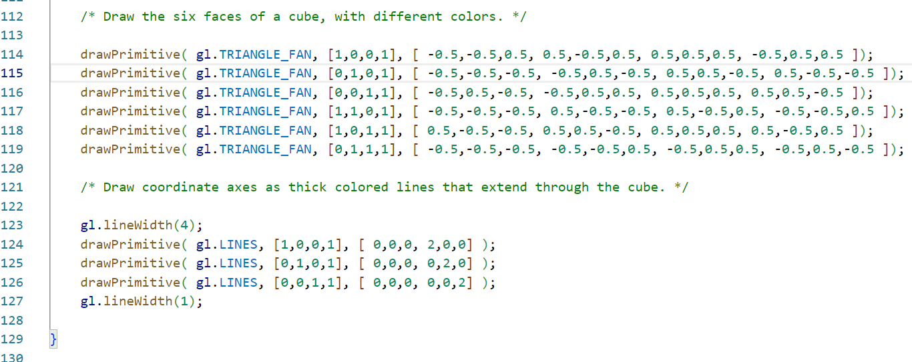
mycube_2.html
There is an additional drawing:
  Three lines along the x, y, and z axis, using red, green, and blue color

Slide 42
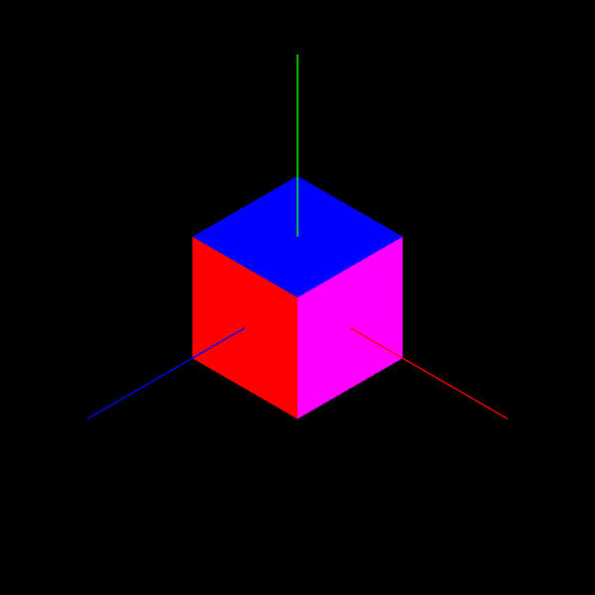
mycube_2.html

Slide 43
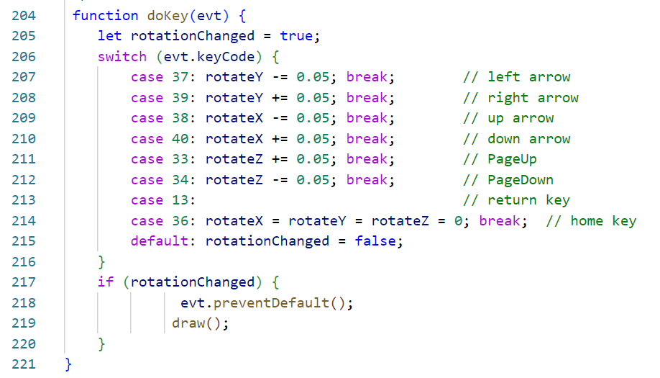
mycube_3.html
Add a keyboard event listener
  In the init(): document.addEventListener("keydown", doKey, false);

Slide 44

Next Topic
Lighting and Material

